Slide 1
Taste and Smell
Prof. Deepthi de Silva
Department of Physiology
D de Silva
Neurosciences Module

Slide 2
At the end of this lecture you should be able to
Taste
State the main types of taste and the characteristics of taste sensation
Outline the structure of a taste bud and their locations
Outline the mechanisms of transduction of taste sensation
Outline the pathway for taste
Smell
Outline the structure and location of the olfactory mucosa
Outline the transduction of smell
Outline the smell pathway
D de Silva
Neurosciences Module

Slide 3
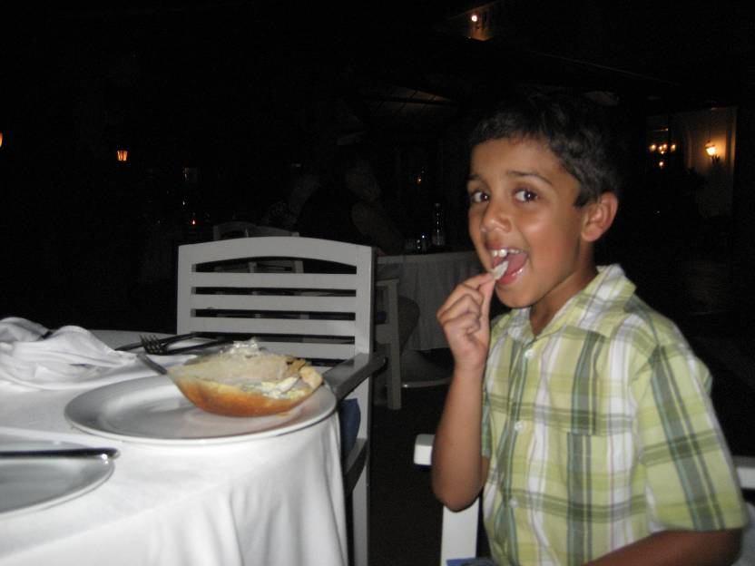
D de Silva
Neurosciences Module

Slide 4
Taste
Sensory organ - ‘taste bud’
  >10,000 in humans
Smell, pain (e.g. chilli) & texture of food also important
Five primary tastes
  Sour
  Salt
  Sweet
  Bitter: high levels cause rejection of food
  Umami
Complex tastes are combination of primary taste
D de Silva
Neurosciences Module

Slide 5
Taste
Taste preference
  On bodily needs
  Past experience
Threshold for taste
  Bitter has low threshold compared with sugar
Crude ability to separate intensities of taste
Adaptation of taste receptors occurs rapidly
  At receptors level
  Within CNS
D de Silva
Neurosciences Module

Slide 6
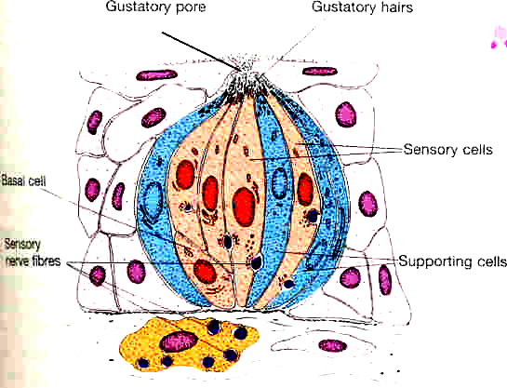
The taste bud
Taste cells (3 types) & basal cells
Gustatory pore
Gustatory hairs (microvilli)
  taste receptors projecting to oral cavity
Sensory fibres at base of taste cells
  50 fibres per bud
  Each fibres gets afferents from around 5 taste buds
Gustatory pore
Gustatory
hairs
Taste
cells
Basal
cells

Slide 7
Location of taste buds
Tongue
  fungiform (front)
  circumvallate papillae & foliate (V shape in back)
Palate, pharynx, Epiglottis
All 5 tastes felt in all parts of tongue
Fungiform
5 taste buds
Vallate
100 taste buds
D de Silva
Neurosciences Module

Slide 8
Taste | Stimulus
Sour | H+ and others
Salt | Any ionised salt e.g Na+, K+
Sweet | Organic chemicals Sugar, glycol, aldehydes, some AA, esters, ketones
Bitter | Organic chemicals Nitrogen containing or alkaloids (many poisons)
Umami (“delicious” in Japanese) | L-glutamate
D de Silva
Neurosciences Module

Slide 9
Transduction of taste
Taste sensation stimulates microvilli
  ? Role of taste molecule binding protein
Opening of cation channels
  Ligand gated (salt and sour)
  G protein coupled receptors (sour, bitter, umami)
Receptor potential generated
Saliva eventually removes taste stimulus from taste bud
D de Silva
Neurosciences Module

Slide 10
Taste pathway
VII chorda tympani branch (anterior 2/3 tongue), IX (posterior 1/3) and X (all others) cranial nerves
Nucleus of tractus solitarius [ipsilateral medulla]
Medial lemniscus [ipsilateral]
Ventral posteromedial complex of thalamus [ipsilateral]
Somatosensory cortex and insular area [ipsilateral]
D de Silva
Neurosciences Module

Slide 11
Post central gyrus- foot
Thalamus
Insula
Tractus
solitarius
VII, IX, X
Nucleus of the
tractus solitarius
Taste bud
D de Silva
Neurosciences Module

Slide 12

Smell
Tomcat prepares for his hot date
Poorly understood
Less developed in humans

Slide 13
Smell (Olfaction)
Olfactory epithelium superior part of nose
  Not well ventilated; sniffing increases smell
  Contains olfactory cells, stem cells, supportive cells and mucus secreting glands
Smell receptor- Olfactory cells (bipolar)
  Olfactory cilia project to mucosal surface
  Axon penetrates cribiform plate
Afferents in olfactoy nerve
Pain via trigeminal nerve: triggers sneezing, tearing & other reflexes
D de Silva
Neurosciences Module

Slide 14
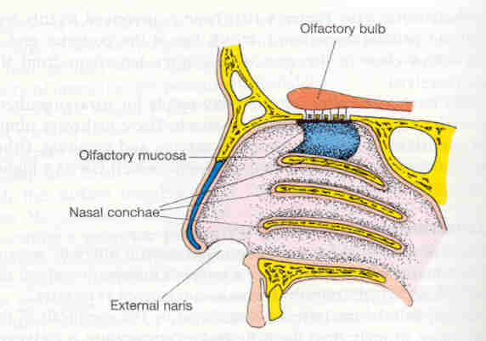
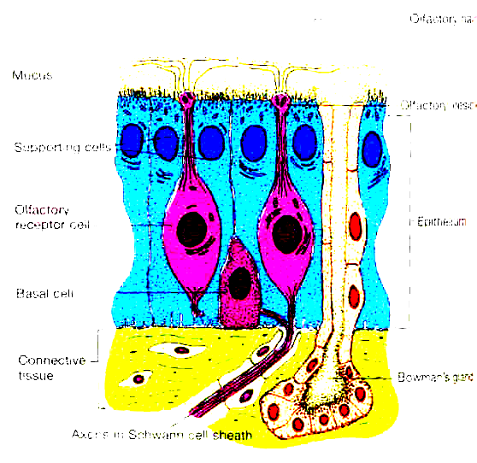
cilia
Olfactory bulb
mucus
Dendrite
Olfactory
epithelium
Receptor cell
External nares
Location of the olfactory mucosa
Structure of the olfactory mucosa
D de Silva
Neurosciences Module

Slide 15
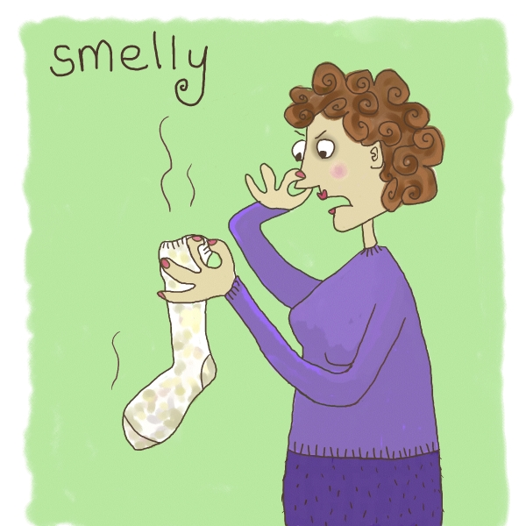
Smell
Wide variety of smells detected (>10,000)
Around 500 genes code for recepors
Wide threshold for smell
  Small, water & lipid soluble molecules have more smell
Poor ability to identify intensity
  Need >30 fold difference
Adaptation of receptors occurs rapidly
Reduction in smell with age

Slide 16
Smell signal transduction
Odorant substance diffuses into mucus
  Lipid soluble odours bind odorant binding protein
Binds receptors in cilia
  G protein coupled: 2nd messenger opens cation channels
Graded receptor potential generated
Causes depolarisation of cell
  If above threshold level, an AP in olfactory nerve
D de Silva
Neurosciences Module

Slide 17
Smell pathway
Olfactory cells’ axons
Pain: via Vth nerve
free endings
Stimulate sneezing
Penetrate cribiform plate
Olfactory glomeruli in olfactory bulb
Olfactory cortex
Amygdala (emotions)
Entorhinal cortex-
Memory areas
Frontal cortex and via thalamus to orbitofrontal cortex R> L for accurate smell

Slide 18
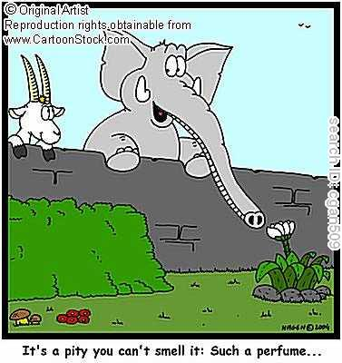
It’s a pity you cant smell it……
D de Silva
Neurosciences Module

Slide 19
Can you
Taste
State the main types of taste and the characteristics of taste sensation
Outline the structure of a taste bud and their locations
Outline the mechanisms of transduction of taste sensation
Outline the pathway for taste
Smell
Outline the structure and location of the olfactory mucosa
Outline the characteristics of smell sensation
Outline the transduction of smell
Outline the smell pathway
D de Silva
Neurosciences Module

